Slide 1
Academic Review A dive into the effects of different variables on student performance in US Public Schools
Paper Straws. LLC
Notes:
mw

Slide 2

Motivation
NFL → Radiation → Books → Plastic Waste → Education
Background: The team decided on Education due to the numerous and robust datasets available, and less so due to personal interest in the topic.
Reasoning:
Discoursed topic
Relatable topic
Digestible topic
Enrollment in GT bootcamp
David’s kids
Notes:
mw

Slide 3
Core Questions and Hypotheses
Is student performance* in the US affected by student:teacher ratio?
Is student performance* in the US affected by teacher salary?
Is student performance* in the US affected by school financials?
Is student performance* in the US affected by per student spending?
Null hypotheses (Ho): Student:teacher ratio does not have an effect on student performance
Null hypotheses (Ho): Teacher salary does not have an effect on student performance
Null hypotheses (Ho): School financials do not have an effect on student performance
Null hypotheses (Ho): Per student spending does not have an effect on student performance
*”Student performance” defined as High School graduation rate
Notes:
scott

Slide 4

Discovery and Analysis
Notes:
scott

Slide 5

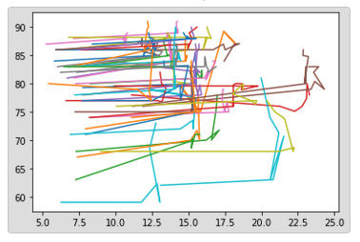

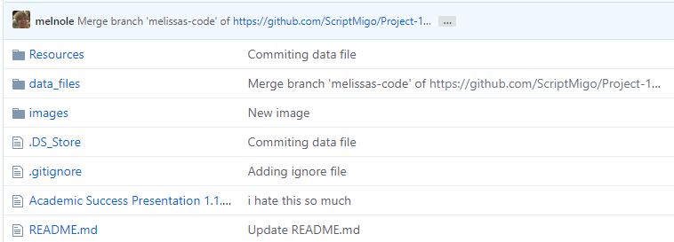

Our Process
Notes:
Sean

Slide 6

Discovery and Data Sources
Google
Kaggle
US Department of Education
US Department of Labor
National Center for Education Statistics (NCES)
National Education Association (NEA)
Census
Our Brains!
Notes:
Sean

Slide 7
Data Cleanup
Deep dive into datafiles
Identify outliers and issues from visualizations
Cleanup directly in excel file as well as Jupyter notebooks
Oklahoma
Alabama
etc
Re-defined parameters
Re-established metrics
Notes:
Saurin

Slide 8
Data Analysis
Review datasets
Discuss strategy
Brainstorm visualizations
Manipulate data real-time
Determine charts and chart types for presentation
Identify data for statistical analysis requirement
Analyze data and visualizations, uncover findings
Notes:
Saurin

Slide 9
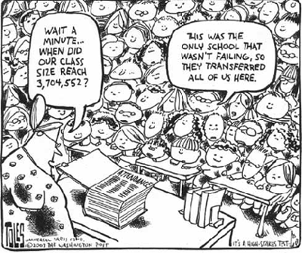
Findings
Notes:
Saurin

Slide 10
US Public Schools Overview
~57m students attended elementary, middle, and high schools across the US in 2019
Highest enrollment ever reported for public schools
3.7m teachers 2019
Average salary $59k
US gov’t allocates 8% to public schools ($706B)
Best graduation rate:
Missouri 88%
Worst graduation rate:
DC 69%
Notes:
mw

Slide 11
Key Findings
Notes:
scott

Slide 12
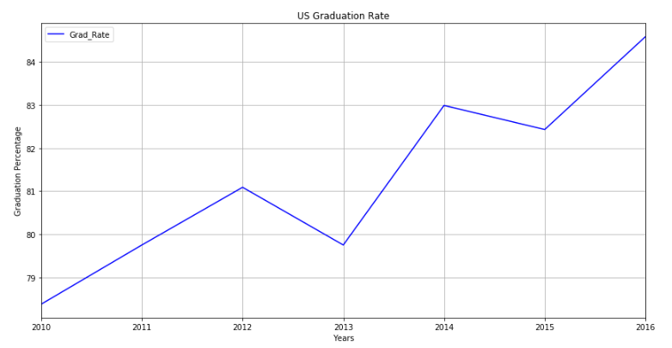
Aggregate Findings – US Trends
2013: Change in grading system to focus less on standardized testing and more on knowledge and life skills
Notes:
Saurin

Slide 13
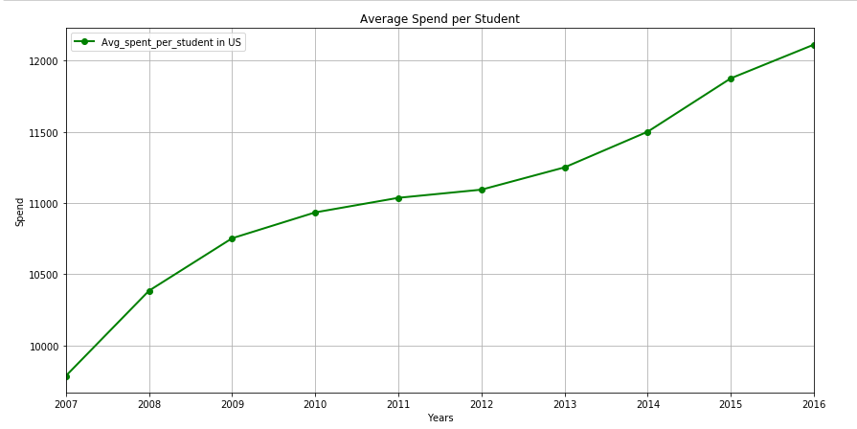
Aggregate Findings – US Trends
2013: Seeming correlation with change in grading system in which avg spend per student increases. 2010-2012 was essentially flat
Notes:
Saurin

Slide 14
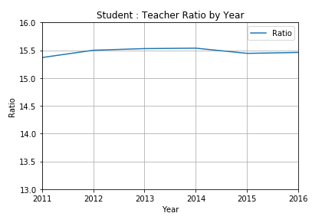
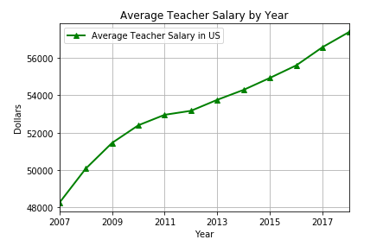
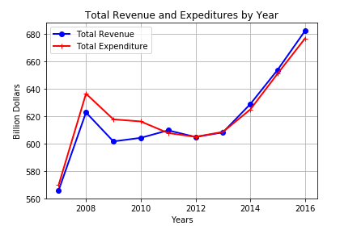
Aggregate Findings – US Trends
Notes:
Saurin

Slide 15
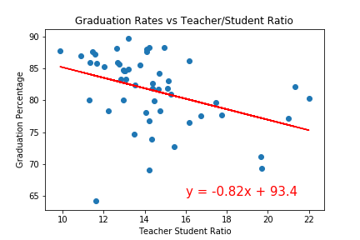
Granular Findings - State Regress
Notes:
sean

Slide 16
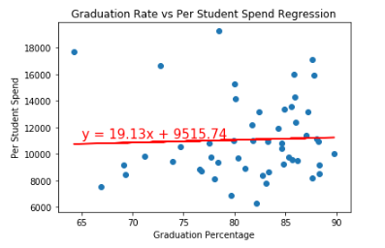
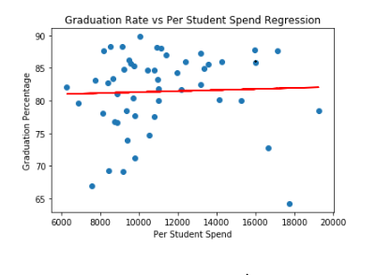
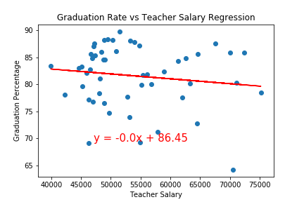
Granular Findings - State Regress
y = 0.0x + 80.51
Notes:
sean

Slide 17
Micro Findings – Georgia Regress
This is the first class not required to take the Georgia High School Graduation Test in order to receive a regular diploma, as Georgia moves away from a one-size-fits-all approach to graduation.
2013
There is evidence that focusing less on testing, and more on career education and personalized paths to graduation, opens up opportunities for students. The graduation rate for students who complete a Career Pathway is much higher – at 89 percent – than the rate for students who do not.
Moving forward, the GaDOE will continue to focus on personalized learning rather than a standardized approach – including Career, Technical and Agricultural Education (CTAE) and core credit flexibility, including the new flexibility that allows students to receive a math, science, or foreign language credit for a computer programming course.
The agency is also working to improve the graduation rate for students with disabilities through a statewide systemic improvement plan which establishes a network of regional support to support local districts in implementing interventions provided by the National Dropout Prevention Center.
Notes:
mw

Slide 18
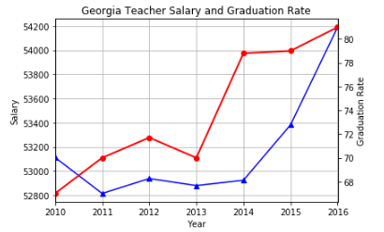
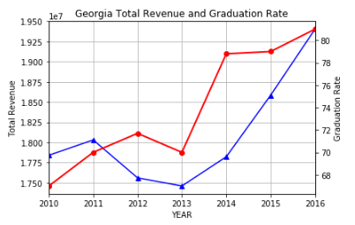
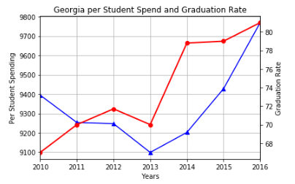
Micro Findings – Georgia
Notes:
mw

Slide 19
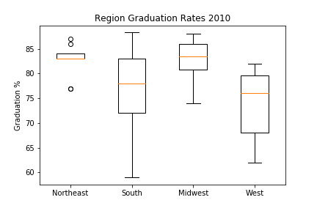
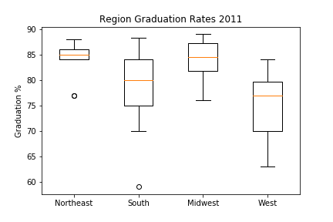
Regional Findings – Statistical Testing
Notes:
scott

Slide 20
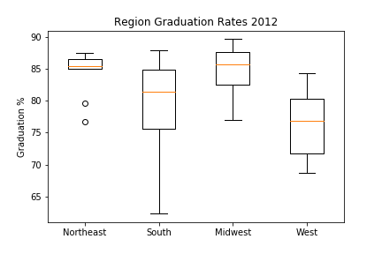

Regional Findings – Statistical Testing
Notes:
scott

Slide 21
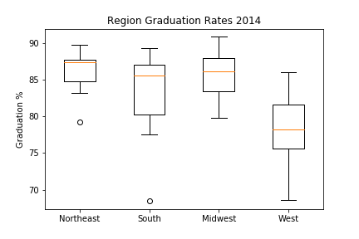
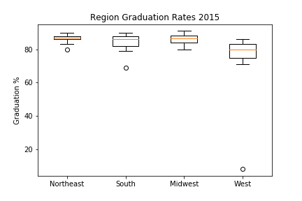
Regional Findings – Statistical Testing
Notes:
scott

Slide 22
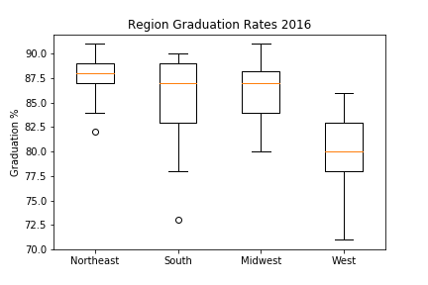
Regional Findings – Statistical Testing
Notes:
scott

Slide 23

Implications
Notes:
scott

Slide 24
Implications
Discuss the implications of your findings. This is where you get to have an open-ended discussion about what your findings "mean".
Notes:
Sean/saurin

Slide 25
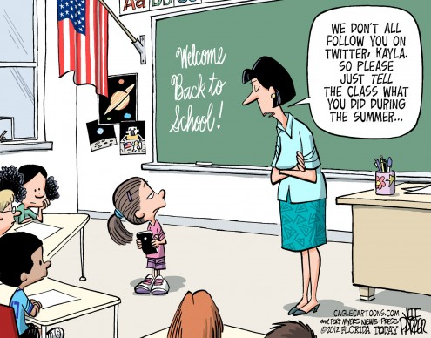
Appendix
Notes:
mw

Slide 26
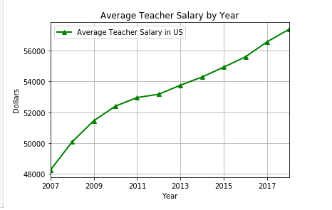
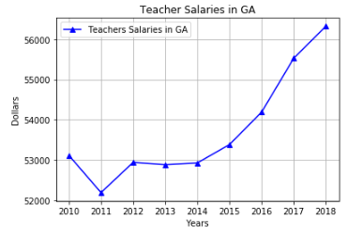
US v GA Average Teacher Salary

Slide 27
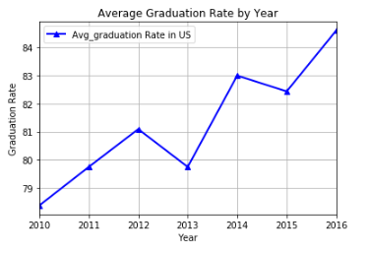
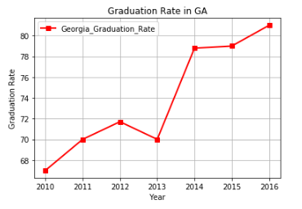
US v GA Graduation Rates

Slide 28
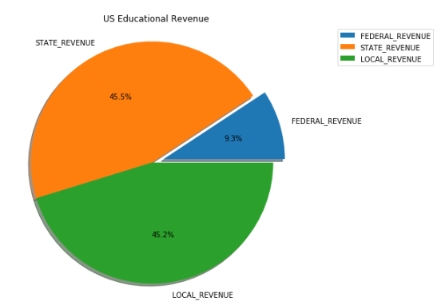
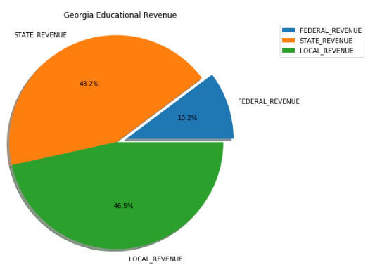
US v GA Educational Revenue

Slide 29
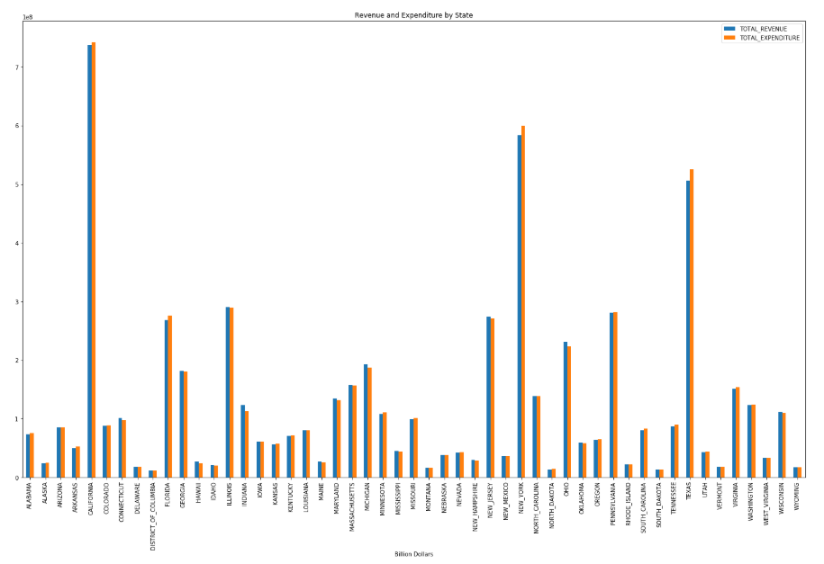

Slide 30
